Slide 1

Predicting Burned Calories on Workout
T5 Data Science Bootcamp
BY
Aishah Alanazi
Rahaf Almayouf
Munira Alshahrani
Hussain Al-Sultan

Slide 2
Overview
Introduction
Workflow
Data overview/Description
Exploring Data Analysis (EDA)
Models
Challenges
Tools
Conclusion

Slide 3
Introduction
Target
Calories are measure of energy. Since calories are, effectively, energy, any time energy is used or transformed in our body we consume calories.
-Uncovering the most effective way to burn calories by analyzing the contributing factors
-Exploring the factors that affect how high or low the heart rate during workout session
-Comparing the duration that males and females spend at workout session
-Comparing the calorie burn rate to workout time.
-Comparing the time spent at working out to different age groups.

Slide 4
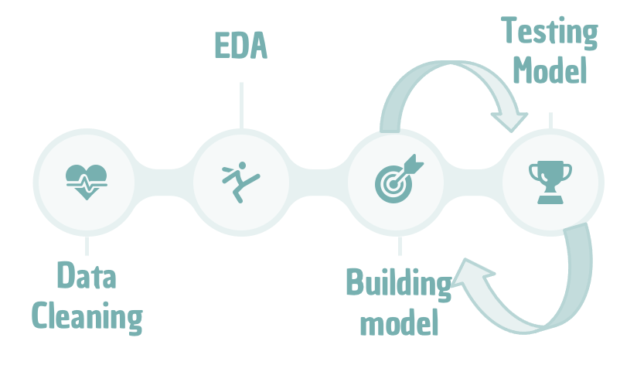
Workflow

Slide 5
Data Overview/Description
Size: 15,000 observations and 9 features
Source : from Kaggle
Features:
User_ID | Gender | Age | Height | Weight | Duration | Heart_rate | Body_Temp | Calories

Slide 6
EDA-Analysis
How can age affect performance time during a workout?
What are the factors that affect how high or low heart rate during a workout?
What is the rate of burning calories compared to the time of workout?
What is the difference between male and female in the duration of workout and burned calories?
What is the relationship between weight and burned calories?
What are the oldest ages that achieve high calorie burn?

Slide 7
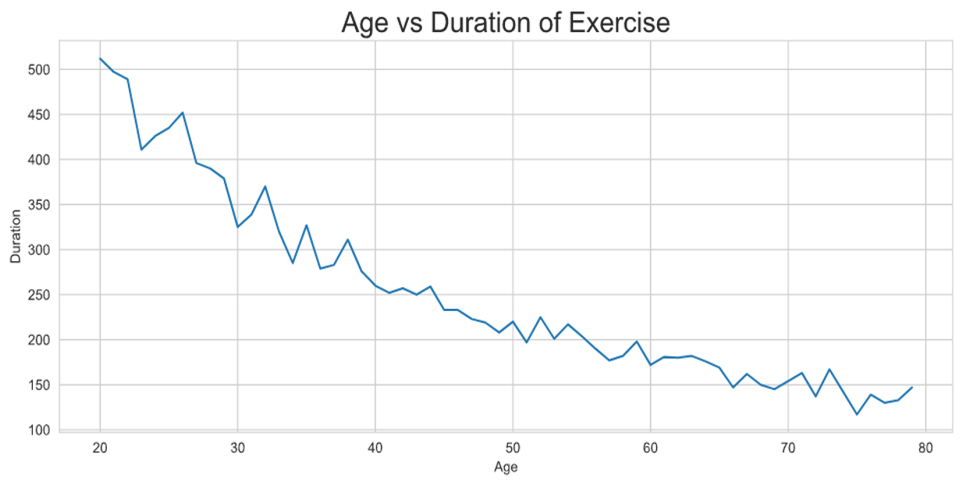
EDA-Analysis
Q1) How can age affect performance time during a workout?

Slide 8
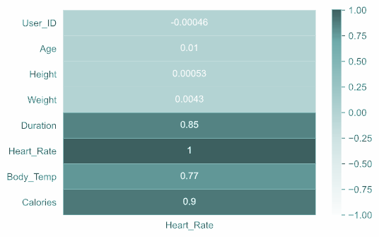
EDA-Analysis
Q2) What are the factors that affect how high or low heart rate during a workout?

Slide 9
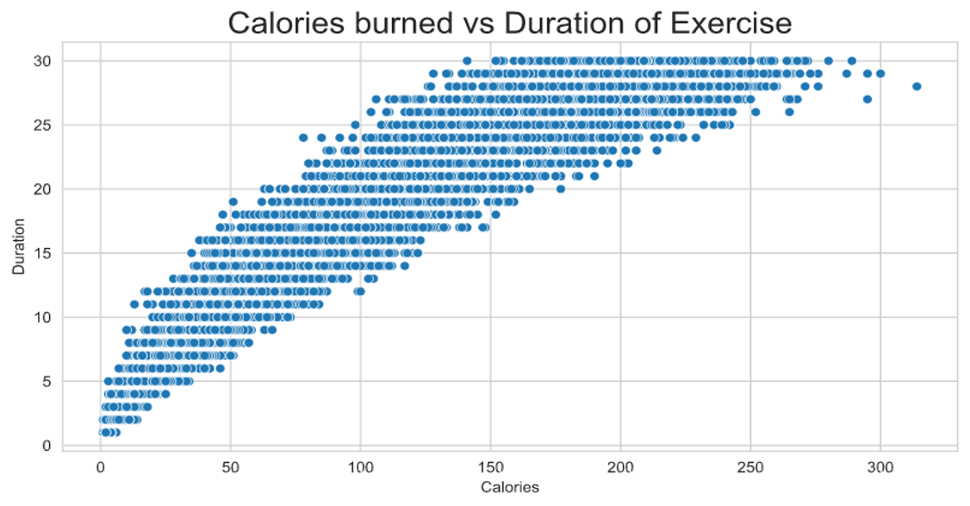
EDA-Analysis
Q3) What is the rate of burning calories compared to the time of workout?

Slide 10
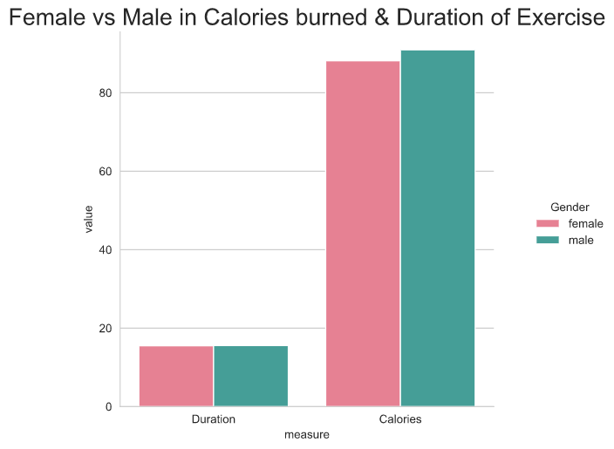
EDA-Analysis
Q4) What is the difference between male and female in the duration of workout and burned calories?

Slide 11
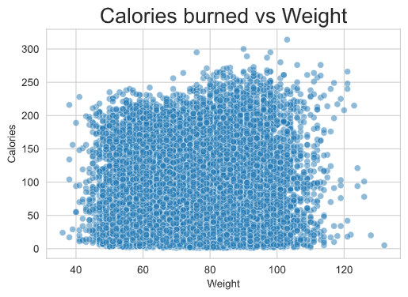
EDA-Analysis
Q5) What is the relationship between weight and burned calories?

Slide 12
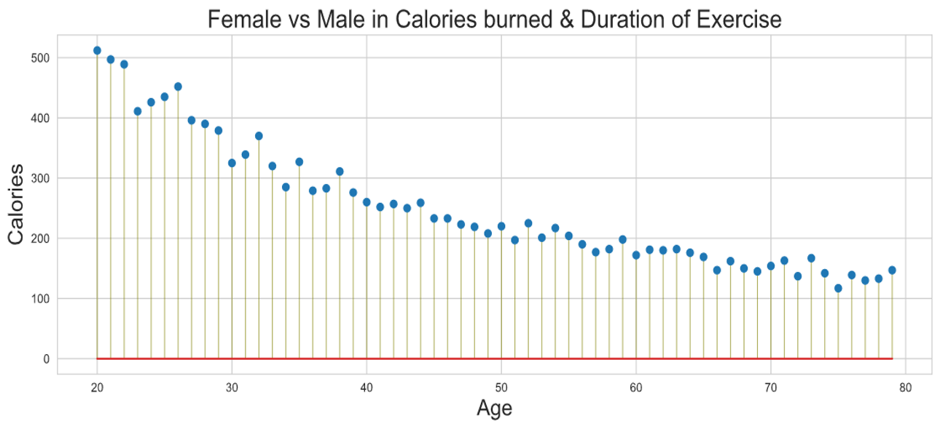
EDA-Analysis
Q6) What are the oldest ages that achieve high calorie burn?

Slide 13
Models
Linear Regression
Pre-processing
One feature regression
Feature selection
Comparison
Three features regression
Feature selection
Comparison
Polynomial Regression
Decision Tree Regression
Random Forest Regression

Slide 14
Pre-processing
Dummies variable
Scaling

Slide 15
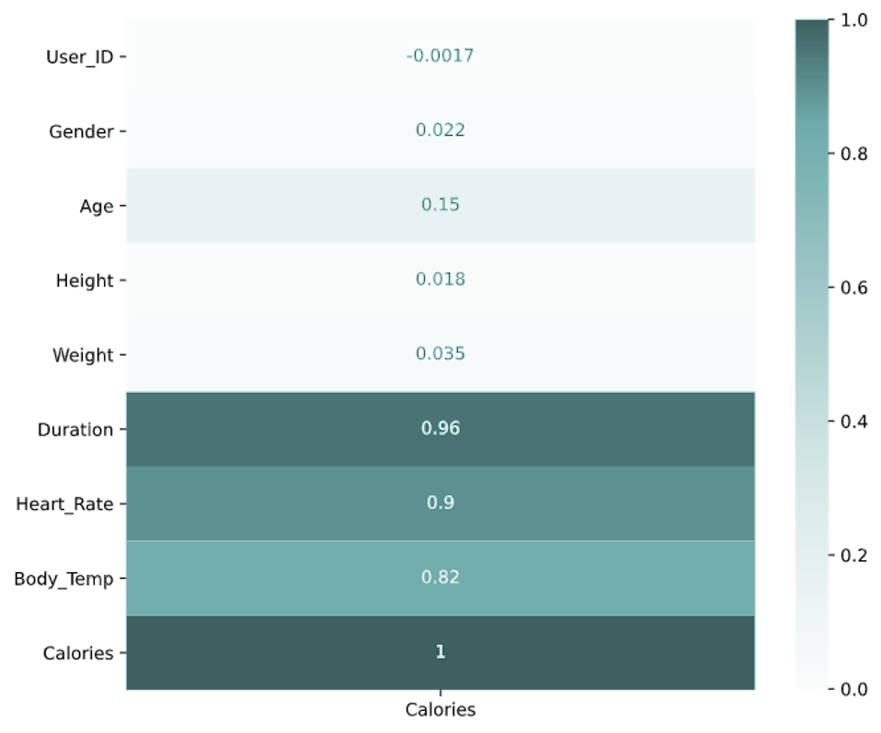
One Feature Regression
Feature Selection
Duration

Slide 16
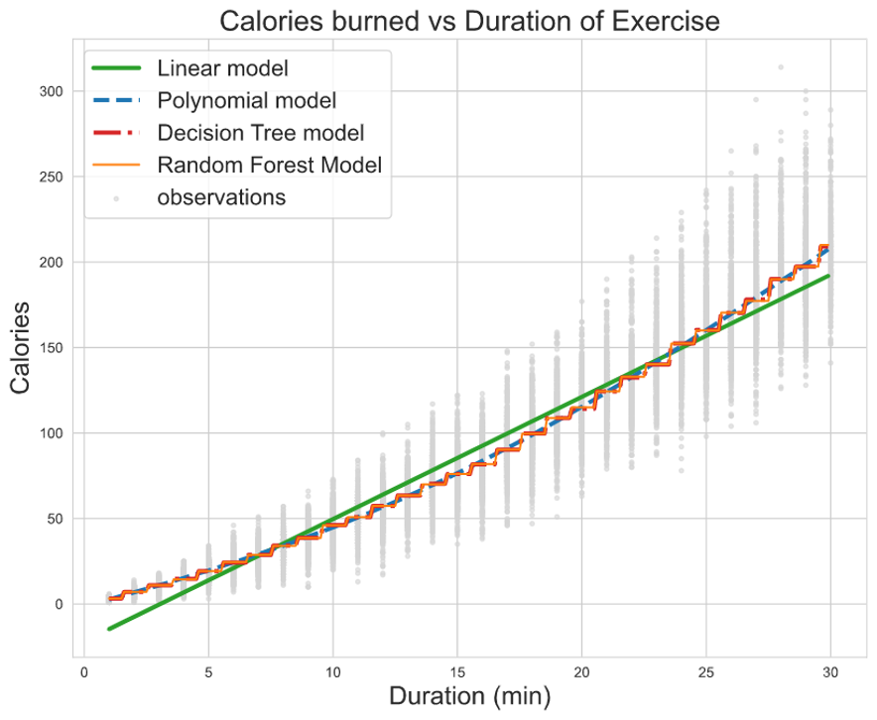
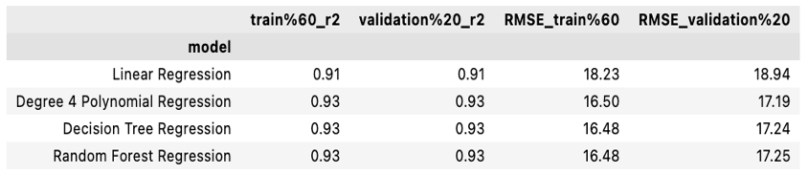
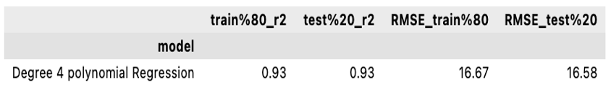
One Feature Regression
Comparison
Train models
Test models

Slide 17
Three Feature Regression
Feature Selection
Duration
Body_Temp
Heart
Rate

Slide 18
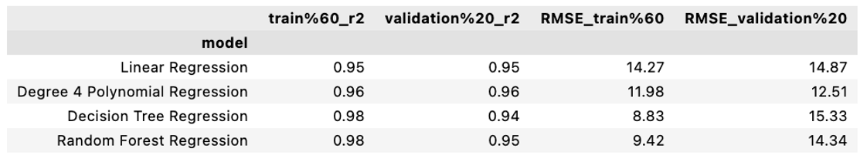
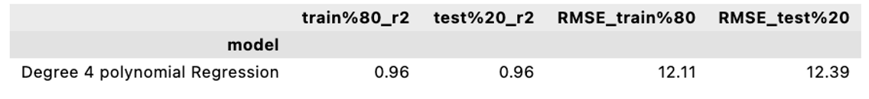
Three Feature Regression
Comparison
Train models
Test models

Slide 19
Challenges
Time
Hard to Visualize 3 features
illogical Results

Slide 20
Tools
Libraries
Softwares
NumPy
Matplotlib
Seaborn
Plotly
Sklearn
Pandas
Trello
GitHub
Jupyter
VSCode
Zoom & Google duc
PowerPoint & Word

Slide 21
Conclusion
Recommendations
Age group 20-30 have high potential to join Gym membership, therefore our team conclude that we should give them some offers.
Future Recommendations
If we have had more information about the date and time of workout in the dataset that we got, we would have worked on the electrical equipment usage during the 24/7 period that will help in more efficient usage of the electrical equipment.
It would decrease the usage of electrical 20-30% [1].

